Slide 1
Introduction to Data Science
Exploratory Data Analysis Part 2

Slide 2
Recap. Exploratory Data Analysis (EDA)
Tools (Week 7)-DONE
1. Introduction to simple statistics
1.1 Population vs sample data
1.2 Measure of centrality (mean, median, mode)
1.3 Measure of spread (std dev, variance)
2. Visualization Methods
2.1 Histograms
2.2 Scatter
2.3 Bar
2.4 Pie, time series, etc.
Analysis (Week 8)
1. Analyze one variable (univariate)
2. Analyze two variables (bivariate)
3. Analyze multiple variables (multivariate)
Output (Week 8)
What questions can the data answer?
What questions can the data NOT answer?
What questions can be asked from the data?

Slide 3
Exploratory Data Analysis (EDA)
Why?
-To discover patterns (correlations)
- To discover anomalies (outliers)
-Frame Hypothesis
-Check Assumptions
Univariate: Explore each individual variable in the dataset
- Summary statistics
- Spread
- Distribution
Bivariate: Assess interactions between variables (or between individual variables and the target)
- Correlation
-Analysis of variance (ANOVA)
Multivariate: Explore data across many dimensions
- Clustering
-Dimensionality reduction

Slide 4
One-Variable Analysis
One-variable analysis is analyzing the dataset by focusing on one variable at a time
If you have salary dataset, you might start with GPA or salary column itself to see pattern
E.g. Looking at salary alone
Question: "How do I compare to my peers? Or What does the salary distribution look like, and where do I stand?"
What can one variable tell us?
  Central tendency (mean, median)
  Spread (range, standard deviation)
  Distribution (histogram, box plot)

Slide 5
Bivariate Analysis
Bivariate analysis explores the relationship between two variables
If you have a salary dataset, you might examine how gender relates to salary
E.g. Analyzing gender vs. salary
Question: "Does gender affect salary? Or How does salary differ between gender groups?"
What can two variables tell us?
Relationship strength (correlation)
Group differences (mean comparison)
Distribution patterns (side-by-side box plots, grouped histograms)

Slide 6
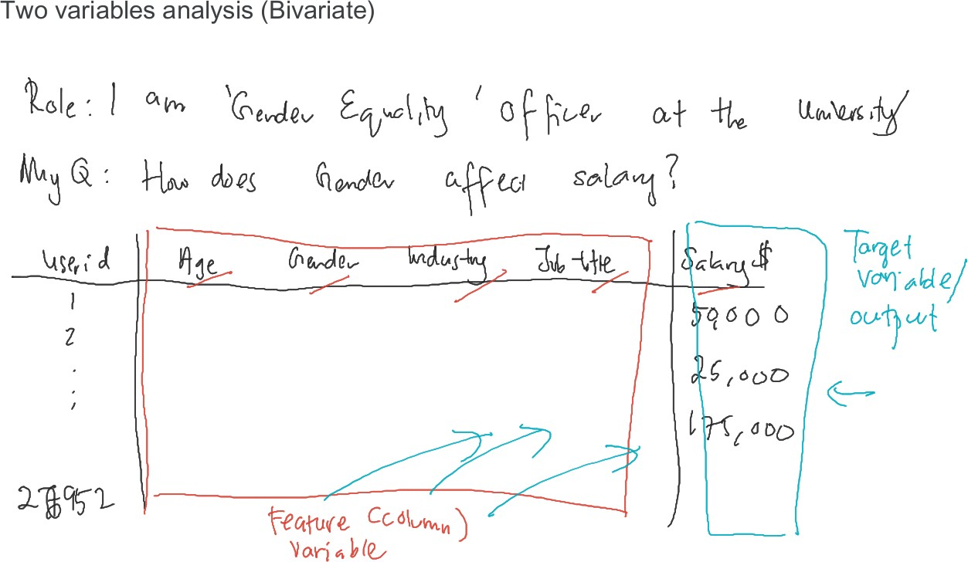














Slide 7
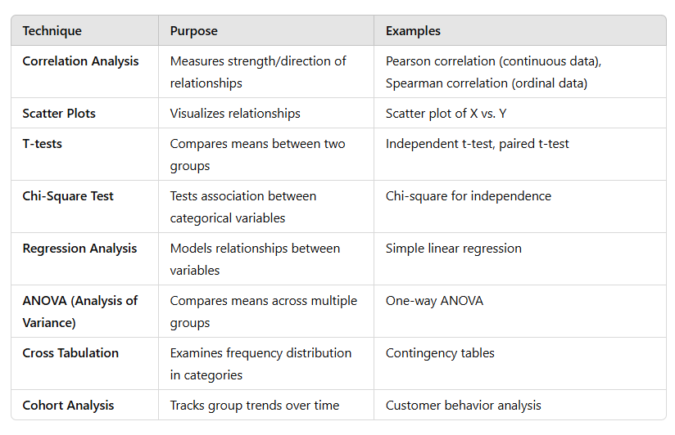
Bivariate Analysis Techniques

Slide 8
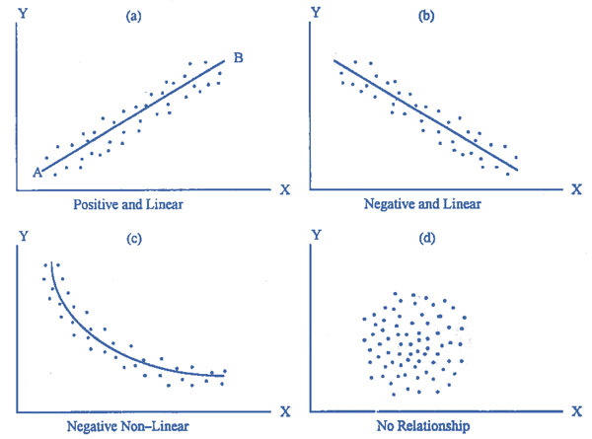

Slide 9
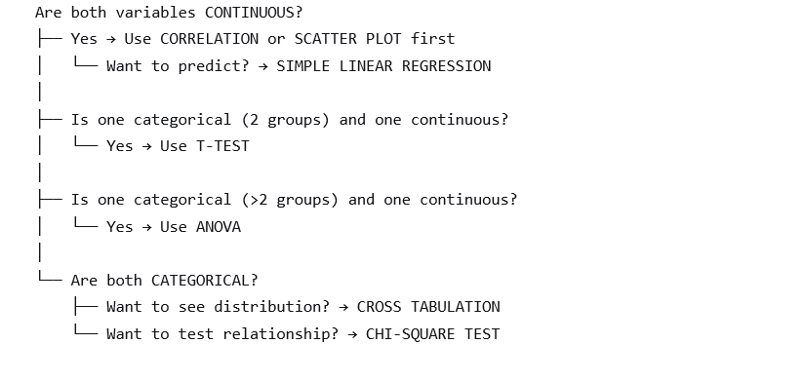

Slide 10
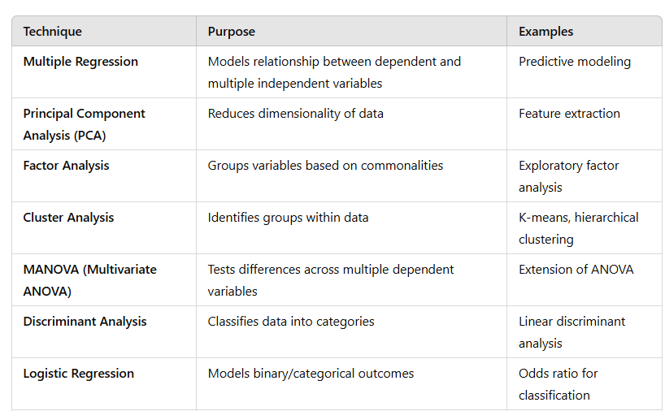
Multivariate Analysis Techniques

Slide 11
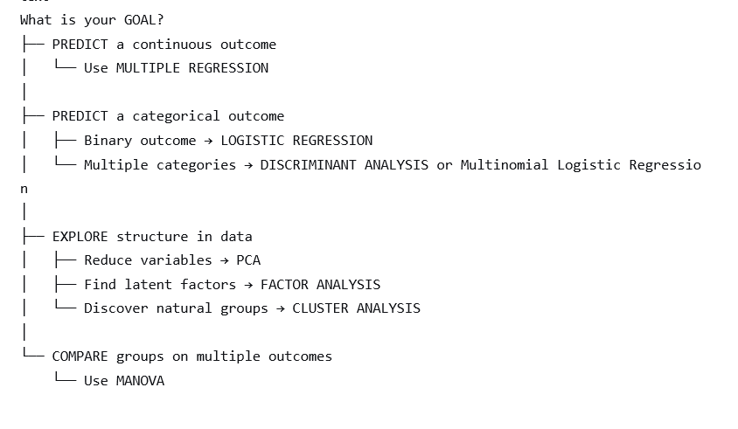

Slide 12
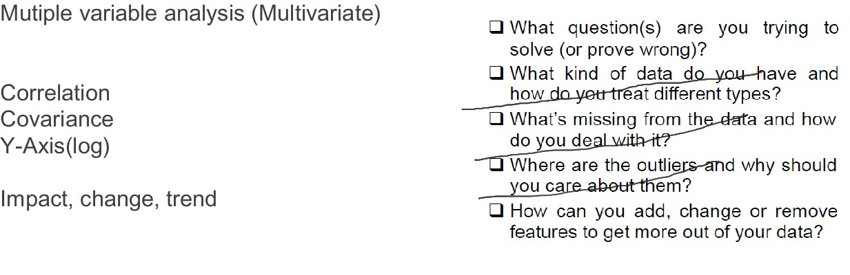

Slide 13
Why have a lecture on data exploration?
When we start our process, all we have is a CSV, with no idea what we have.
There’s generally no label and no guide.
It’s useful to have a process for exploring it.

Slide 14
Exploratory data analysis
Exploratory Data Analysis refers to the critical process of performing initial investigations on data so as to
discover patterns
spot anomalies
test hypothesis and
to check assumptions with the help of summary statistics and graphical representations.

Slide 15
Exploratory data analysis (EDA)
Before making inferences from data it is essential to examine all your variables.
Why?
To listen to the data:
- to catch mistakes
- to see patterns in the data
- to find violations of statistical assumptions
- to generate hypotheses
…and because if you don’t, you will have trouble later
It is a good practice to understand the data first and try to gather as many insights from it.
EDA is all about making sense of data in hand, before getting them dirty with it.

Slide 16
Exploratory data analysis (EDA)
EDA provides a structured process for approaching this scenario. Involves a series of steps and techniques to
systematically explore the data,
uncover hidden patterns, and
gain insights.
This process ensures that you don't miss critical information and can make informed decisions about subsequent analyses or modeling.
EDA also emphasizes the importance of data visualization

Slide 17
Aim of Exploratory data analysis (EDA)
Maximize insight into a dataset.
Uncover underlying structure.
Extract important variables.
Detect outliers and anomalies.
Test underlying assumptions.
Develop valid models.

Slide 18
3 steps to understand the Cycle of EDA
Generate questions about your data
Search for answers by visualizing, transforming, and modeling your data
Use what you learn to refine your questions and or generate new questions
Rinse and repeat (until you publish a paper or your boss approved it!)

Slide 19
Asking the Right Questions
What type of questions we should ask that gives us a clear picture.
Two types of questions will always be useful for making discoveries with your data.
1. What type of variation occurs within my variables?
Ex. Understand the distribution and range of key metrics like revenue and engagement.
2. What type of Co-variation occurs between my variables?
Ex. Explore how different variables interact. For example, does increased engagement lead to higher revenue?

Slide 20
Asking the Right Questions
Identifying the Key Variable of Interest: Generally, there will be one column you care about the most: Revenue, engagement, survival, etc. Focus on how the other variables relate to that.
Understanding Relationships, Considering Dependencies:
You’ll also need your common sense! Think about what columns might be related, what might contribute to what, what might dependent or independent.
Start your analysis with a list of questions, but don’t be afraid to change them!

Slide 21
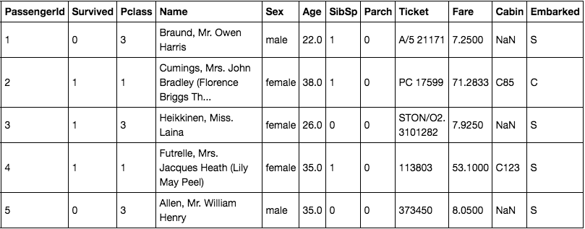
REMEMBER:
Asking questions and conducting EDA reveal insights, patterns, and trends, aiding analysis and decision-making.
Use suitable visualizations and statistical tests to support findings.
Demographic Breakdown: What is the demographic profile of passengers?
Overall Survival Rate: What was the overall survival rate on the Titanic?
Age Impact: Did age affect survival rates?
Class Survival: Were higher-class passengers more likely to survive?
Fare Distribution: What was the distribution of fares paid?
Family Survival: Were families more likely to survive together?
Embarkation Point: Did the point of embarkation influence survival?
Gender Influence: How did gender affect survival rates?
Name Patterns: Were there interesting patterns in passenger names or titles?
Feature Correlation: What is the correlation between features like age, fare, and class?
Class Survival by Gender: What was the survival rate by class, broken down by gender?

Slide 22
REMEMBER:
Asking questions and conducting EDA : Start your analysis with a list of questions based on your initial hypotheses and domain knowledge.
Refine your questions to gain a deeper understanding of the factors, if needed.
Do first-class passengers have a higher survival rate compared to third-class passengers?"
Is there a significant difference in survival rates between males and females?"
How does age impact the likelihood of survival?
Are passengers who embarked from different ports more likely to survive?"
Focus on: you're not only describing the data but also seeking meaningful explanations for observed patterns

Slide 23
EDA Checklist
Define Objective: What question(s) are you trying to solve (or prove wrong)? Clearly state the problem or question you aim to address with the data. Having a clear objective guides the analysis and ensures focus.
Understand Data Types: What kind of data do you have and how do you treat different types? Identify the types of data present in the dataset (e.g., numerical, categorical) and understand how to handle each type appropriately.
Handle Missing Data: What’s missing from the data and how do you deal with it (e.g., imputation, deletion)? [NEXT CLASS TOPIC]
Detect Outliers: Where are the outliers and why should you care about them? Outliers can skew results and need to be assessed for their relevance and potential handling.
Feature Engineering: How can you add, change or remove features to get more out of your data?
An EDA checklist If a checklist is good enough for pilots to use every flight, it’s good enough for data scientists to use with every dataset.

Slide 24
Thank You

